Slide 1

Skagit County
5-year Homeless Housing Plan
2025-2030
October 27th, 2025
Madeleine Anthony & Megan Starr
Housing & Community Services
Skagit County Public Health

Slide 2
Homeless Housing Task Force
Ariell Wright, Catholic Community Services
Brad Johnson, City of Burlington
Charlie Bush, City of Sedro Woolley
Dustin Johnson, Anacortes Family Center
Genevieve Ward, Mount Baker Presbyterian Church
Heidi Roy, Skagit County Domestic Violence and Sexual Assault Services
Jonathan Kline, Skagit Friendship House
John Coleman, City of Anacortes
Jose Ortiz, Catholic Community Services
Kat Lohman, Skagit Valley YMCA
Kaylynne Nyberg, Volunteers of America
Leon John, Didgwalic Wellness Center
Mary Meyer, Mount Baker Presbyterian Church
Melanie Corey, Housing Authority of Skagit County
Sarah Vogt, Welcome Home Skagit
Steve Sexton, City of Mount Vernon
Linda Crothers, North Sound Behavioral Health Administrative Services Organization
Sandi Phinney, Community Action of Skagit County

Slide 3
Purpose of Plan Provides goals, strategies, activities, performance measures and timelines to eliminate homelessness within the entire county.
Blueprint for implementation
Reference for funding decisions
Tool for Advocacy
Support the development of homeless housing capital developments that comply with the Growth Management Act and local comprehensive plans
Required by WA State Law RCW 43.185C.050
Notes:
We hope to use this plan over the next 5 years to guide our work plan and funding decisions, and we hope that it will be useful to the community at large as a tool for advocacy. We are able to update this plan with the state as needed over the next 5 years.

Slide 4
Plan Status Update
Draft is posted
Feedback incorporated from the Public & Task Force
Final Draft Approved and Adopted by County Commissioners
Submitted to WA State. Dept Of Commerce
Public Hearing
November 4th

Slide 5
2025-2030 Objectives Required by the Department of Commerce
Promote an equitable, accountable and transparent homeless crisis response system
Strengthen the homeless service provider workforce
Prevent episodes of homelessness whenever possible
Prioritize assistance based on the greatest barriers to housing stability and the greatest risk of harm
House everyone in a stable setting that meets their needs
*New Objective*: Eliminate unaccompanied youth and young adult homelessness
Notes:
How do State objectives fit within local context?
Are there additional objectives that should be added to the list?
1. Promote an equitable, accountable and transparent homeless crisis response system
2. Strengthen the homeless service provider workforce
3. Prevent episodes of homelessness whenever possible
4. Prioritize assistance based on the greatest barriers to housing stability and the greatest risk of harm
5. House everyone in a stable setting that meets their needs

Slide 6
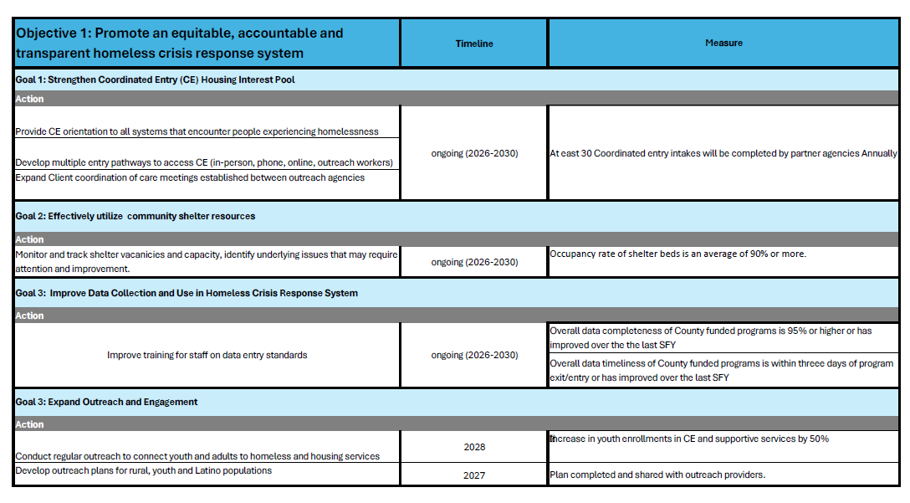

Slide 7
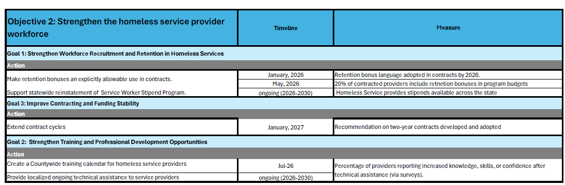

Slide 8
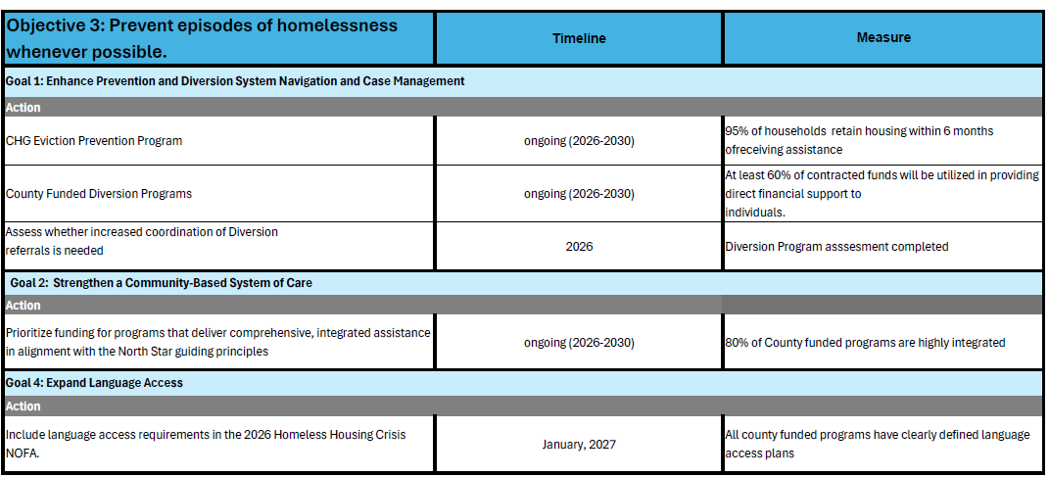

Slide 9
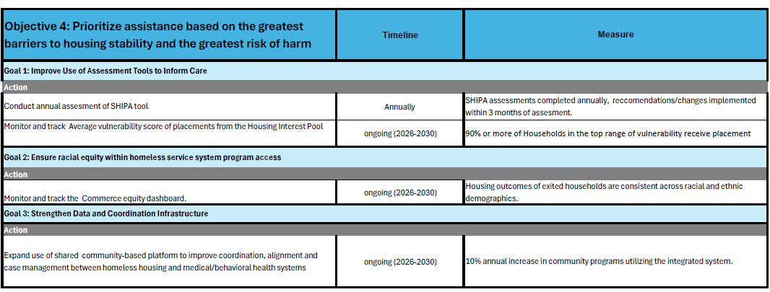

Slide 10
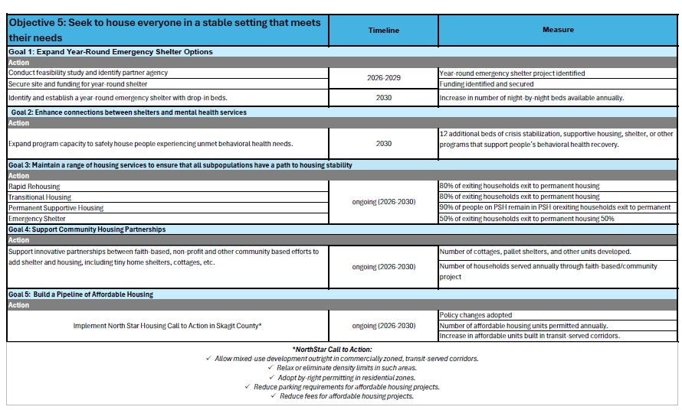

Slide 11
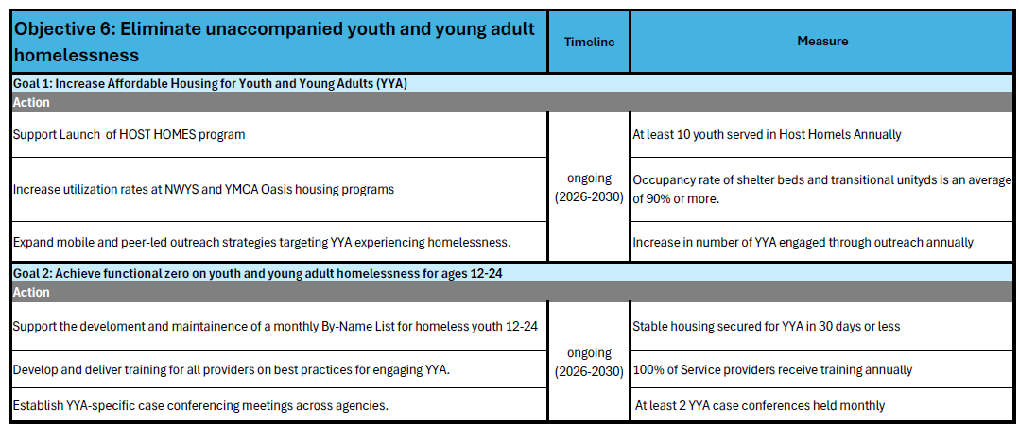

Slide 12
Public Comments Received
Community Member from Anacortes
I urge the County to consider:
Integrating income supports with housing programs – Connect housing initiatives to living wage campaigns, job training, and employment support so people can afford rent without permanent reliance on charitable resources.
Advocating for living wages – Ensure local wages reflect the true cost of housing and basic necessities.
Supporting small businesses – Paying living wages can be difficult for local employers due to taxes, fees, and Labor & Industries costs. Policies that reduce certain fees or offer incentives for small businesses can make living wages more feasible.
Implementing renter protections – Consider rent caps or stabilization measures to prevent sudden or excessive rent increases that displace families.
Taking a systemic approach – Emergency shelters and transitional housing are essential but not sufficient. A holistic solution should address both housing supply and income stability.
Notes:
The local plan must include the 2024-2029 State Homeless Housing Strategic Plan objectives Megan- updates slide

Slide 13
Public Comments Received
Parent of a homeless individual
There is a lack of truly low-barrier shelters
We risk more and more challenging individuals to be on the streets in our community if we do not look for resources to serve the highest barrier individuals
Employment Service Provider
Skagit County has zero emergency overnight shelters
211 call took 45 minutes and got no resources but a voicemail for a shelter
People transitioning from jail would like to go to Oak Harbor or Bellingham for shelter but it is a parole violation to leave the County, so they are stuck homeless here
Staff in Skagit are frustrated, and people are terrified and in pain due to lack of shelter
Notes:
The local plan must include the 2024-2029 State Homeless Housing Strategic Plan objectives Megan- updates slide

Slide 14
Suggestions?
Thank you for participating in the Task Force!
Megan Starr
Housing Resource Coordinator
Skagit County Public Health
360-416-1506
mstarr@co.skagit.wa.us
Madeleine Anthony
Housing Resource Coordinator
Skagit County Public Health
360-416-2014
manthony.@co.skagit.wa.us

